Slide 1
Backpropagation Algorithms
First step is the propagation of input signals forward through the network.
Second step is the adjustment of weights based on error signals backward through the network.

Slide 2
Backpropagation Algorithm Procedure
First Step
1. Initialization of the connection weights as small random numbers.
2. Feeding the input to the input units: Input_{p}=(I_{p1}, I_{p2}, …, I_{pi}), where Input_{p} is the pth training example.
3. Computation of the net values (weighted sum) of the hidden units is the weight from the input unit i to the hidden unit j.
4. Computation of the output values of the hidden units is the output function of the hidden unit j.
5. Computation of the net values (weighted sum) of the output units is the weight from the hidden unit j to the output unit k.
6. Computation of the output values of the output units is the output function of the output unit k.

Slide 3
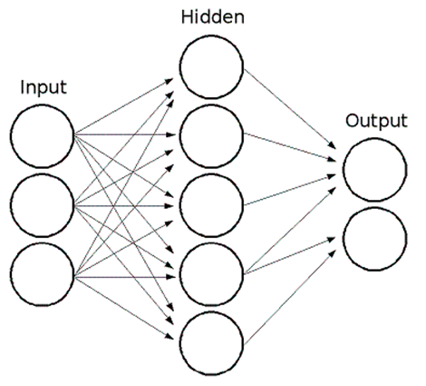
First step: Backpropagation Algorithms
When an input comes into the input layer, the input value propagates to the output layer through the hidden layer.
With the input, weights, and activation functions, this step generates outputs of hidden units and output units.
This actual output value is compared with the desired target output value.
If the desired target output and the actual output of the neural network have different results, the connection weights are changed in the second step.
input
data
actual
output
target
output
data
actual
output

Slide 4
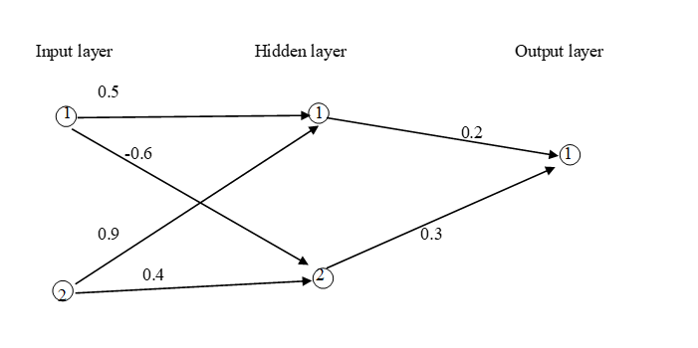
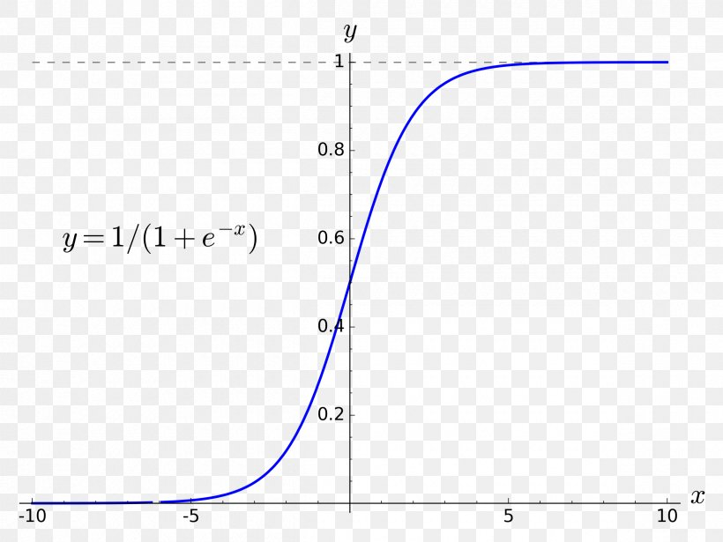
Example of First Step
The Training data
The value 1 is injected into input unit1
The value 1 is injected into input unit2.
The target output in output unit1 is 0.
The initial weights are given as right.
The transfer function is a sigmoid function.
Learning coefficient is 0.7.
<Hidden Units>
The net of hidden unit 1: 1 * 0.5 + 1 * 0.9 = 1.4
The net of hidden unit 2: 1 * (-0.6) + 1 * 0.4 = -0.2
The output of hidden unit 1: 1 / 1 + e^{-(1.4)} = 0.802
The output of hidden unit 2: 1 / 1 + e^{-(-0.2)} = 0.450
<Output Unit>
The net of output unit 1: 0.802*0.2 + 0.450*0.3= 0.2954
The output of output unit 1: 1 / 1 + e^{-(0.2954)} = 0.5733
With input data (1, 1), this network generates actual output 0.5733.
How is this output? What is the given target output for the input data (1,1)?
1
0
1

Slide 5
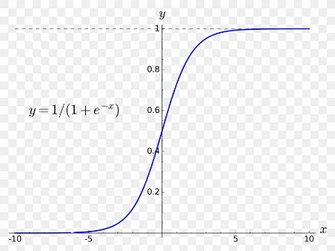
Second step: Backpropagation Algorithms
If the desired target output and the actual output of the neural network have different results, the connection weights are changed in the second step.
The error signals backpropagate from the output layer to the input layer through the hidden layer.
When the node in the network has a differentiable and nonlinear output function like a sigmoid, the gradient search method can be implemented to backpropagate and correct the error of the output.
input
data
actual
output
target
output
data
actual
output

Slide 6
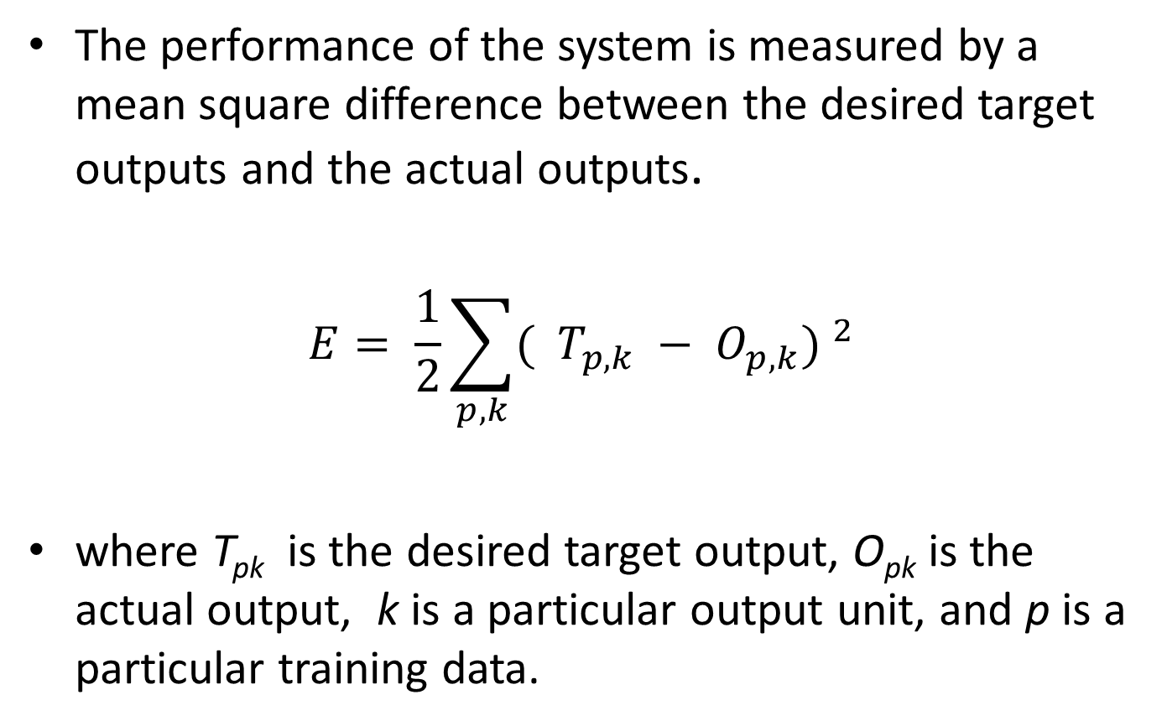
Performance of the system

Slide 7
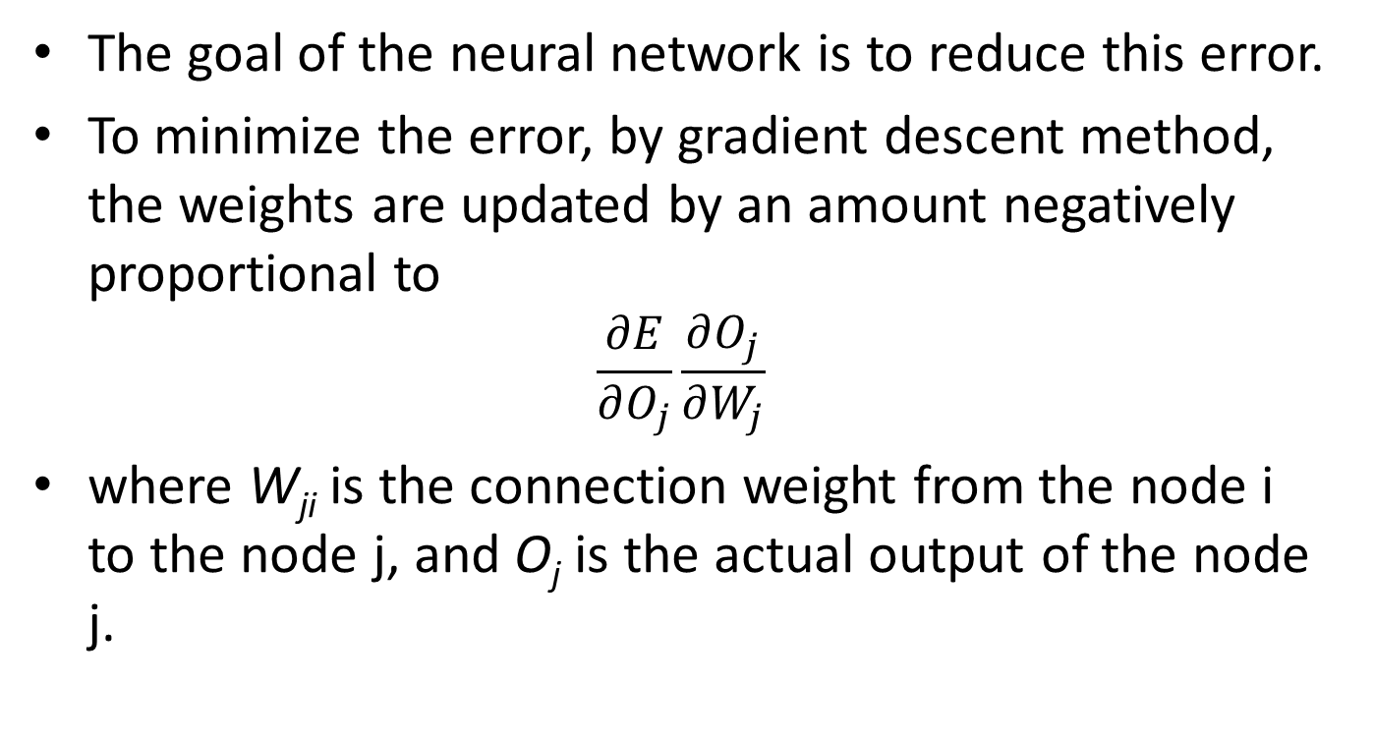
Goal of the neural network

Slide 8
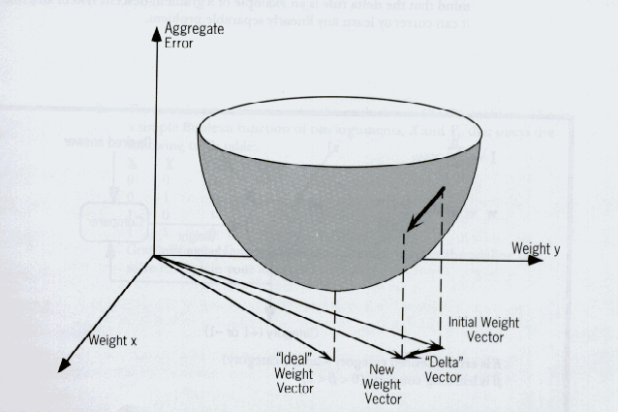
Gradient Descent Method

Slide 9
$\frac{∂E}{∂W_{kj}}$ = $\frac{∂E}{∂O_{k}}$ $\frac{∂O_{k}}{∂W_{kj}}$ = $\frac{∂E}{∂O_{k}}$ $\frac{∂O_{k}}{∂{Net}_{k}}$ $\frac{∂{Net}_{k}}{∂W_{kj}}$
E = $\frac{1}{2}\sum_{p,k}{{\text{(}T_{pk} −O_{pk}\text{) }}^{2}}$
$\frac{∂E}{∂O_{k}}$ = - ($T_{pk} −O_{pk}$)
$\frac{∂{Net}_{k}}{∂W_{kj}}$ = $I_{pj}$

Slide 10
First derivative of $f\left(x\right)=\frac{1}{1+e^{−x}}$
$$f\left(x\right)=\frac{1}{1+e^{−x}}$$
$$f\left(x\right)={(1+e^{−x})}^{−1}$$
$f^{′\left(x\right)}=−{(1+e^{−x})}^{−2}$ ${(1+e^{−x})}^{′}$= $\frac{e^{−x}}{{(1+e^{−x})}^{2}}$
$=\frac{1+e^{−x}−1}{{(1+e^{−x})}^{2}}$ = $\frac{(1+e^{−x})}{{(1+e^{−x})}^{2}}−\frac{1}{{\left(1+e^{−x}\right)}^{2}}=\frac{1}{\left(1+e^{−x}\right)} − \frac{1}{{\left(1+e^{−x}\right)}^{2}}$
$= \frac{1}{(1+e^{−x})} \left(1−\frac{1}{{(1+e^{−x})}^{}}\right)$ $=f\left(x\right) (1−f\left(x\right))$

Slide 11
$\frac{∂O_{k}}{∂{Net}_{k}}$ = $O_{pk}$( 1- $O_{pk}$)
$$\frac{∂E}{∂W_{kj}}\text{ = }\frac{∂E}{∂O_{k}} \frac{∂O_{k}}{∂W_{kj}}\text{ = }\frac{∂E}{∂O_{k}} \frac{∂O_{k}}{∂{Net}_{k}} \frac{∂{Net}_{k}}{∂W_{kj}}$$
$\frac{∂E}{∂O_{k}}$ = - ($T_{pk} −O_{pk}$)
$\frac{∂{Net}_{k}}{∂W_{kj}}$ = $I_{pj}$
Finally,
$\frac{∂E}{∂W_{kj}}\text{ =}$ - ($T_{pk} −O_{pk}$) $O_{pk}$( 1- $O_{pk}$) $I_{pj}$

Slide 12
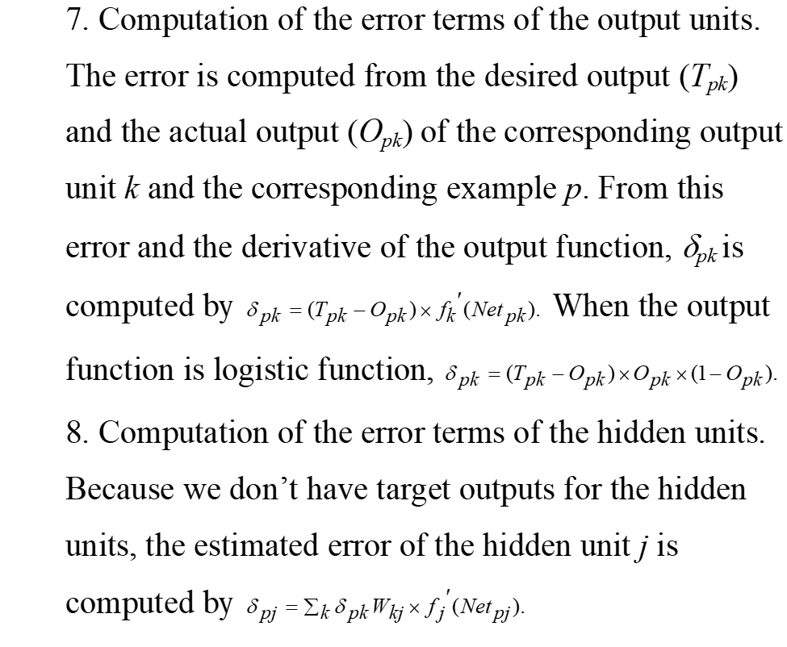
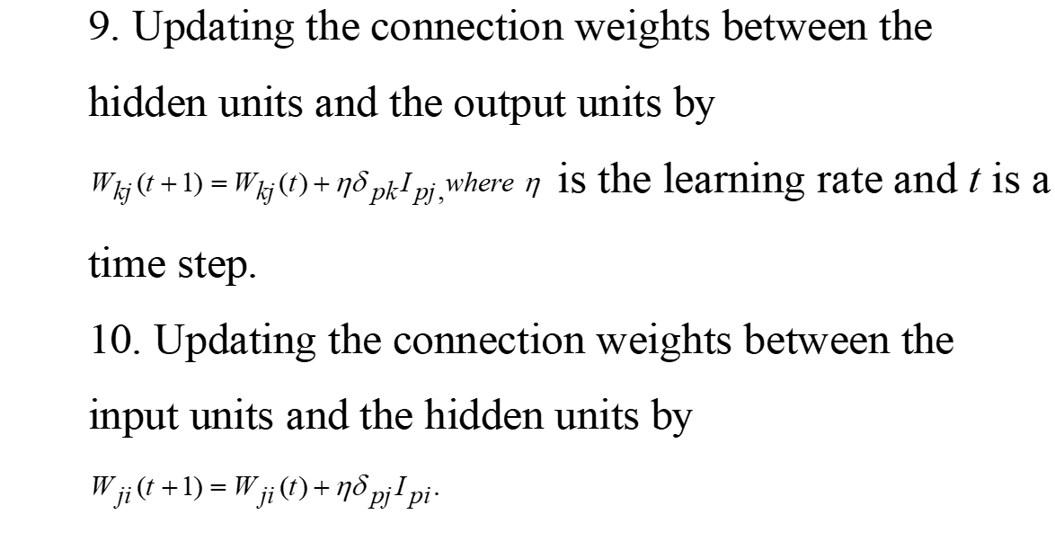
Backpropagation Algorithm Procedure
Second Step

Slide 13
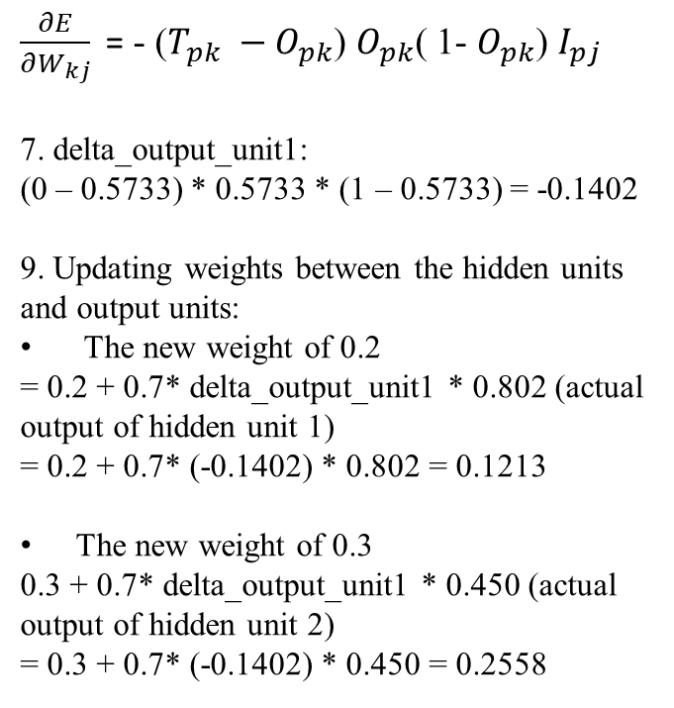
New weights between Hidden layer and Output layer
$\frac{∂E}{∂W_{kj}} \text{=}$ - ($T_{pk} −O_{pk}$) $O_{pk}$( 1- $O_{pk}$) $I_{pj}$
7. delta_output_unit1:
(0 – 0.5733) * 0.5733 * (1 – 0.5733) = -0.1402
9. Updating weights between the hidden units and output units:
The new weight of 0.2
= 0.2 + 0.7* delta_output_unit1 * 0.802 (actual output of hidden unit 1)
= 0.2 + 0.7* (-0.1402) * 0.802 = 0.1213
The new weight of 0.3
0.3 + 0.7* delta_output_unit1 * 0.450 (actual output of hidden unit 2)
= 0.3 + 0.7* (-0.1402) * 0.450 = 0.2558

Slide 14
New weights between Input layer and Hidden layer
The output of Hidden unit1 was 0.802.
The output of Hidden unit2 was 0.450
Delta of output unit1 is -0.1402
delta_hidden_unit1:
delta_ouput_unit1 * 0.2 * 0.802 * (1 – 0.802)
= (-0.1402) * 0.2 * 0.802 * (1 – 0.802) = -0.00445
delta_hidden_unit2:
delta_ouput_unit1 * 0.3 * 0.450 * (1 – 0.450)
= (-0.1402) * 0.3 * 0.450 * (1 – 0.450) = -0.0104
0.5 + 0.7 * delta_hidden_unit1 * 1
= 0.5 + 0.7 * -0.00445 * 1 = 0.49691
-0.6 + 0.7 * delta_hidden_unit2 * 1
= -0.6 + 0.7 * -0.0104 * 1 = -0.60728
0.9 + 0.7 * delta_hidden_unit1 * 1
= 0.9 + 0.7 *- 0.00445 * 1 = 0.8969
0.4 + 0.7 * delta_hidden_unit2 * 1
= 0.4 + 0.7 * -0.0104 * 1 = 0.39272

Slide 15
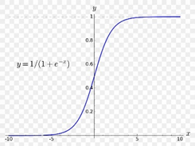
Before and After with given data
The Training data
The value 1 is injected into input unit1
The value 1 is injected into input unit2.
The target output in output unit1 is 0.
The transfer function is a sigmoid function.
Learning coefficient is 0.7.
Before
After

